Slide 1
Software product management Introduction
Nandagopal Govindan

Slide 2
Contents
Software products scenario
What is spurring product industry?
Different product categories
Project business vs Product business
What is Product management?
About this course

Slide 3
Software products scenario

Slide 4
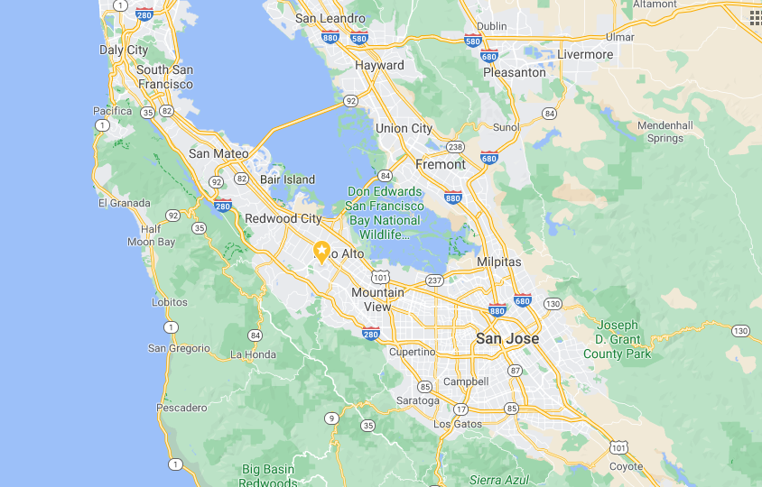
Software product revolution started in Silicon valley
Stanford University
Silicon valley
Early companies in Silicon valley: HP, Xerox, Apple, Oracle,…..

Slide 5
How Silicon Valley became successful?
Convergence of Academia (Stanford, UC Berkley), the Private Sector, and Government
High Density of Wealthy Investors and Funding Institutions
Inspiration From Past Success Stories
Cultural diversity: Half the startups belong to Indians and Chinese
Level-headed Approach to Failure

Slide 6
Today there are 950+ unicorns across the world
Country | # of Unicorns
United States | 300+
China | 140+
India | 50+
United Kingdom | 30+
Germany | 12
South Korea | 11
https://www.cbinsights.com/research-unicorn-companies

Slide 7
Unicorns by industry
Industry | # of Unicorns
Fintech | 80+
Internet software & services | 70+
E-commerce & direct-to-consumer | 70+
Artificial intelligence | 50+
Mobile & telecommunications | 35+
Health | 35+
https://www.cbinsights.com/research-unicorn-companies

Slide 8
Growth of start-ups in India
The number of start-ups has grown from 7,000 in 2008 to 50,000 in 2017, according to the latest report by KPMG on the startup ecosystem in india
KPMG report: https://home.kpmg/in/en/home/insights/2019/01/startup-landscape-ecosystem-growing-mature.html

Slide 9
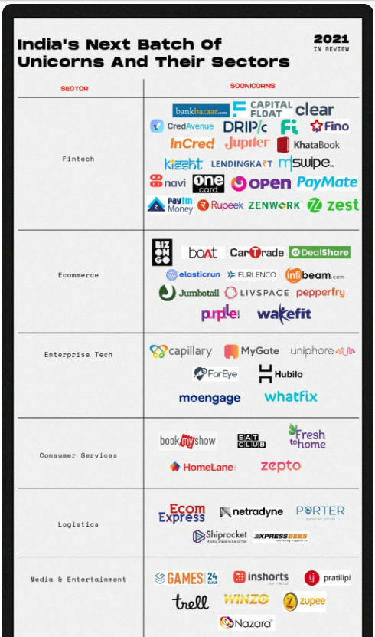

Slide 10
Upcoming unicorns start-ups in India
India has 73 potential unicorns in 2021, up from 52 soonicorns in 2020, with Bengaluru leading the list followed by Mumbai and Delhi-NCR
The emergence of new models in fintech, consumer services and ecommerce has revitalised funding in these sectors
As startups raise capital at high valuations, investors caution against short-term thinking around growth at the cost of unit economics
https://inc42.com/features/the-next-unicorns-soonicorn-startups-in-india/

Slide 11
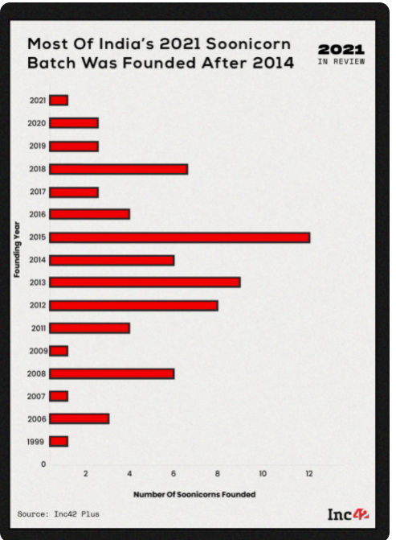
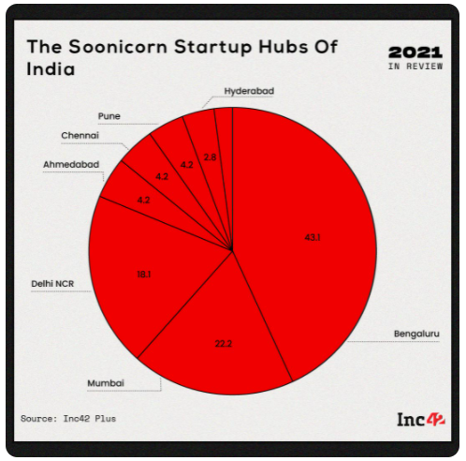

Slide 12
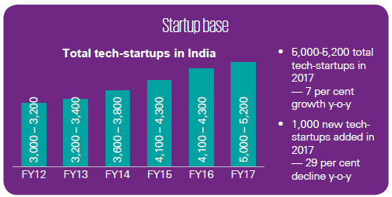
Tech start-ups growth in India
KPMG report: https://home.kpmg/in/en/home/insights/2019/01/startup-landscape-ecosystem-growing-mature.html

Slide 13
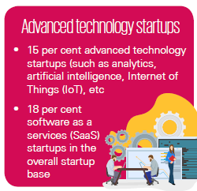
Tech start-ups – Advanced technology (India)
KPMG report: https://home.kpmg/in/en/home/insights/2019/01/startup-landscape-ecosystem-growing-mature.html

Slide 14
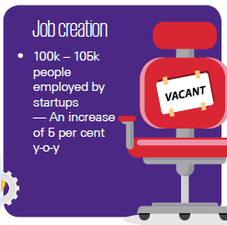
Tech start-ups – job creation (India)
KPMG report: https://home.kpmg/in/en/home/insights/2019/01/startup-landscape-ecosystem-growing-mature.html

Slide 15
What is spurring product industry?
Global market reach
Cloud resources – Amazon AWS, Microsoft Azure, IBM, Google
Funding - 100 angel investors in 2020
Talent pool

Slide 16
Unicorns in India
Courtesy: https://www.investindia.gov.in/indian-unicorn-landscape

Slide 17
Product categories

Slide 18
Product categories
By industry – Finance, Health, Retail, Travel
By technology – AI/ML, Analytics, Robotics, IoT
B2B vs B2C
SaaS vs On-premise
Mobile vs Web
Regular vs API products (Payment gateway, Google Maps, SMS gateway, Banking API)
Product vs Product-cum-service (Ola, Uber, Flipkart)
Product (Paytm), Product platform (Ola), Product family (Office on Windows, Office on Mac, Office on Android), Product Line (Roclwell Collin avionics)
Any other?

Slide 19
Industry segments
E-Commerce – Amazon, Flipkart
HealthTech – Practo, Tata Health, CogniAble
FinTech – Paytm, Wealthy
EdTech - Byju
TravelTech – MakeMyTrip, Tripadvisor
Logistics – Ecom express, Dunzo, Delhivery
Consumer services – Swiggy,
Enterprise Tech – Zoho, Kissflow, Wooqer
Deep tech - Niflr, Logically, AskSarkar
Software dev – Postman, WorkDuck

Slide 20
Product platform
Product platform: Amazon AWS, Android, Uber, PayPal, Facebook
The technical foundation / eco system on which several software products are based.

Slide 21
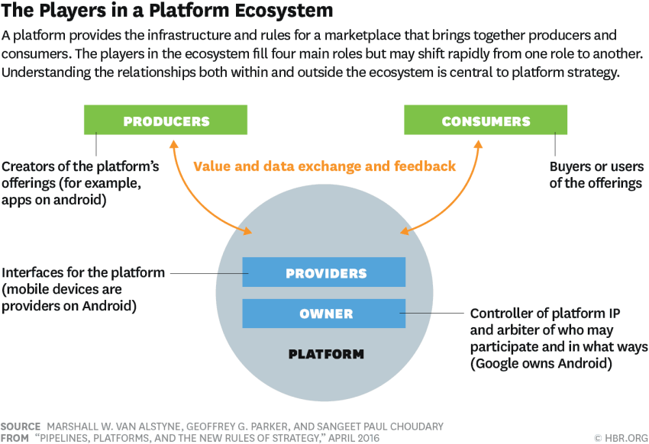
Product platform
Image Source: https://hbr.org/2016/04/pipelines-platforms-and-the-new-rules-of-strategy

Slide 22
Product family
Product family: Microsoft Office (Word, Excel, PowerPoint, OneNote, Outlook)
A group of software products that are marketed as belonging together under a common family name

Slide 23

Product line
Product line: Rockwell Collins Avionics systems for different helicopters
a collection of similar software systems from a shared set of software assets using a common means of production.

Slide 24
Product business and Project business
Dimension | Product | Project
Risk | High | Low
Returns | High | Low
Duration | Ongoing | Pre-determined
Customers | Many | One
Objective | Discovered | Given
Funding | Internal & external | Internal
Marketing effort | High | Low
Management | Strategic | Tactical / operational

Slide 25
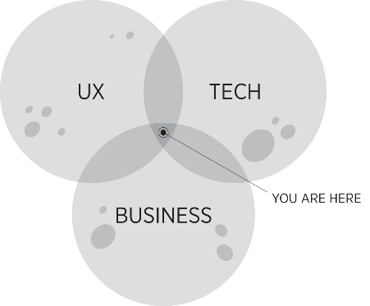
What is Product Management?
“The job of a product manager is to discover a product that is valuable, usable and feasible.” – Marty Cagan, Author of ‘Inspired’
“Product management is an intersection between business, user experience, and technology” – Martin Eriksson, Author of Product Leadership
“Product management is the glue that holds together all the various functions” - Ken Norton, Product Partner at Google Ventures

Slide 26
Product Management role
You need to be really good at strategy, be inspirational, and understand the long-term picture.
At the same time, you have to be really good at the operational side and making things happen
Setting a vision
Creating a roadmap
Build the product
Talk to customers
You need the soft skills of persuasion, negotiation, storytelling, vision setting and communication

Slide 27
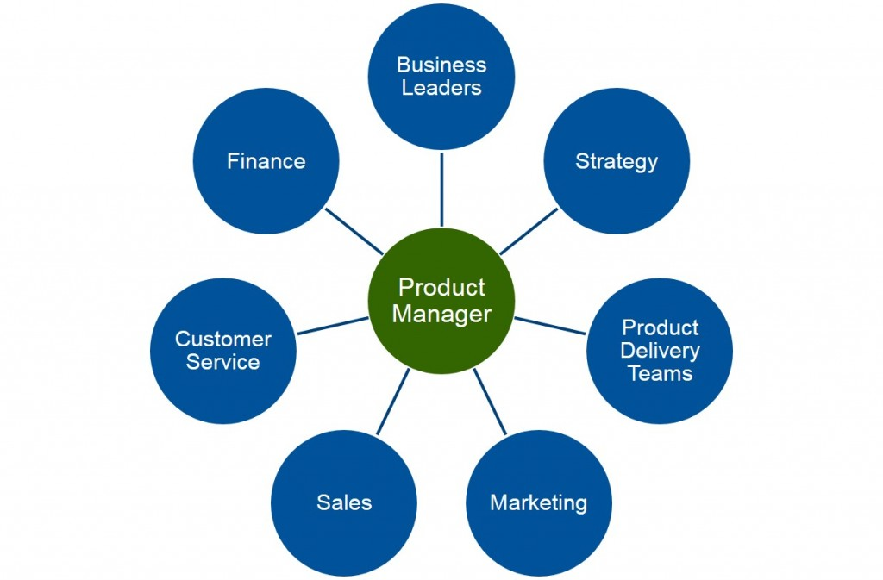
Product Management role
Ref: Product Plan.com

Slide 28
About the course
Hope you have handout.

Slide 29
Sharing thoughts
Name one product company you admire.
What is the reason you admire this company?

Slide 30
Appendix

Slide 31
Examples of Products
Zoom – Simplified Cisco Webex
Ola – Built a platform
Postman – Eco system for API development
Slack – Simplified Team collaboration
Twilio – Tool to Integrate messaging
Kissflow – Business workflow implementation easily
Rivigo – Innovation in logistics
MyGate – Spotted an opportunity

Slide 32

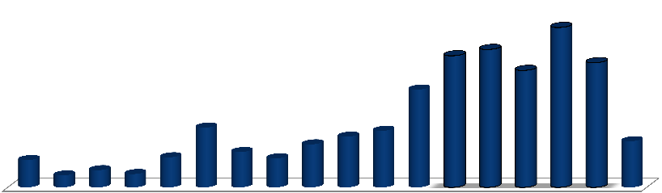
Since 1990, more than 3402 product companies have started in India; however, the YoY numbers vary dramatically due to various other economic variables
Evolution of the Indian Product Business Landscape from the year
1990 to 2012
Due the economic downturn, the number of new product startups reduced in 2009.
458
425 E
395
400 E
377
357
280
335
171
145
162
101
123
132
78
86
83
34
49
38
Till 1995
1996 1997 1998 1999 2000 2001 2002 2003 2004 2005 2006 2007 2008 2009 2010 2011 Q2
2012
Total= 3402
Note: Only companies with visibility/beta product , live in the market have been considered in the database.; E - Estimated Source: Zinnov Analysis
1

Slide 33
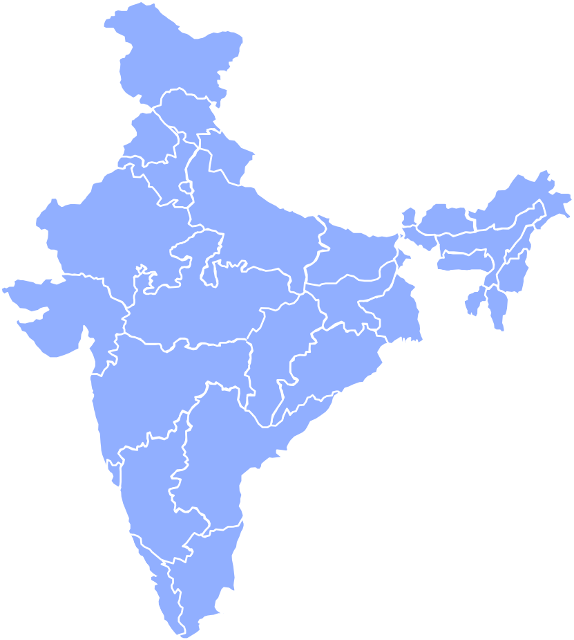













Of the total 3,402 product companies, approximately 51 percent are based in Bangalore and NCR region
Region | Cities
Bangalore | Bangalore, Mysore, Belgaum, Gulbarga, Hubli
Hyderabad | Hyderabad, Secundrabad,Vishakhapatnu m,Vijayawada
Pune | Pune
Chennai | Chennai, Calicut, Trivandrum, Madurai, Coimbatore, Cochin, Vellore
Mumbai | Mumbai, Goa, Ahmedabad, Vadodara, etc.
NCR | Delhi, Gurgaon, Noida, Chandigarh, Mohali
Kolkata | Kolkata, Patna, Bhubaneswar
Product companies split across regions
Kolkata
810
121
NCR
NCR
498
Mumbai
Mumbai
Pune
Hyderabad
Kolkata
227
435
Pune
Bangalore
Hyderabad
929
Total= 3402
382
Bangalore
Chennai
Note: The cities marked in bold are emerging Tier-II cities for product startups
22

Slide 34


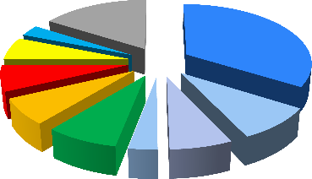
Obtaining funding has proved to be a challenge; however, this is changing as VC investments in this space are rising
VC Investments in India (2005 – 2011)
VC Investments by Industry Value – 2012
1200
240
210
900
1110
180
16%
170
3%
34%
150
6%
140
7%
600
110
120
7%
USD million
950
9%
94
876
8%
3%
7%
700
³⁰⁰ 44
60
508
475
268
0
0
Online Services Mobile VAS
Healthcare & Lifescience BFSI
Food and Beverages
Enterprise Software and Products IT Services and Others
Energy Education Others
2005 2006 2007 2008 2009 2010 2011
Deal Value Number of Deals
Source: Venture Intelligence; Zinnov Analysis
3

Slide 35




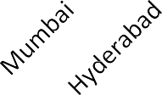


Overall 58 % of the funded companies from 2005 till today are from Bangalore and NCR
VC Investments by companies Location (2005-2012)
Funding timeframe for 2005-2012 companies
3/4th of total
2/3rd of total
Interestingly,
1/6th of startups
were funded in the year of inception
149
92
117
69
74
69
No of Companies
87
No of Companies
46
46
37
37
37
34
21
6
0
1
2 3 4
No of Years for funding
5
6
7
Location
Overall funded companies from (2005-2012) are around 446 (i.e. 19 % of 2407 startups)
Around 66% of the companies obtained funding within 3 years of inception
• 69% of the companies which obtained funding during (2005-2012) are from Digital and Software domain
Source of Funding: VCCircle, Crunchbase, Company Website, Zinnov Database and Secondary research.
4

Slide 36
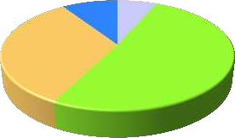




It is noticed that between 2009-12 more than 55% of the startup founders have less than 10 years of experience
Startup Founder’s by Domain – (2009-2012)
Founders
119
Tier 1 | 40
Overseas | 44
Enterprise Software | 196
Telecom | 72
BFSI | 25
Electrical & Electronics | 26
Semiconductors | 30
Others | 76
9%
7%
33%
51%
Product Engineering | 178
Pure Services | 243
ITES | 118
Other | 114
Total = 1282
Freshers
Service Provider
MNC R&D
Serial Entrepreneurs
Startup Founder’s by Experience – (2009-2012)
Total = 1282
4/5th of total
393
Affinity to Startup is very high among people with <15
304
345
years of experience!
¹⁴⁵ 33
42
20
0-5
6-10
11-15
16-20
Years of Experience
21-25 26-30
31+
Source of Founder profiles: Linkedin, Company Website, Zinnov Database and Secondary research.
5

